Slide 1

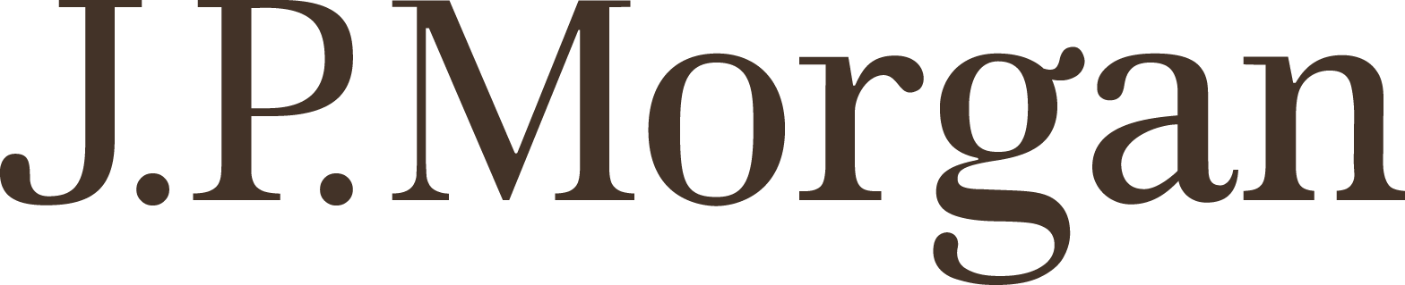
Data Analysis: Project Budget to Actual

Slide 2
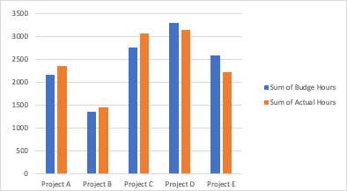
Project C is the most overbudget on hours, and Project E is the most underbudget. Project D has the most both budge and actual hours.

Slide 3
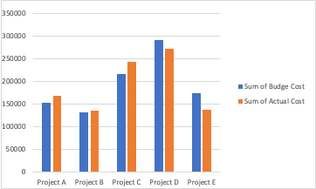
Project C is the most overbudget on cost, and Project E is the most underbudget. Project D has the most both budge and actual cost. Project B has the least both budge and actual hours.

Slide 4
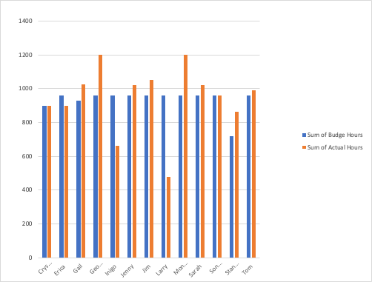
Both George and Monique are over budge on the most hours. Larry is the most inder budget .

Slide 5
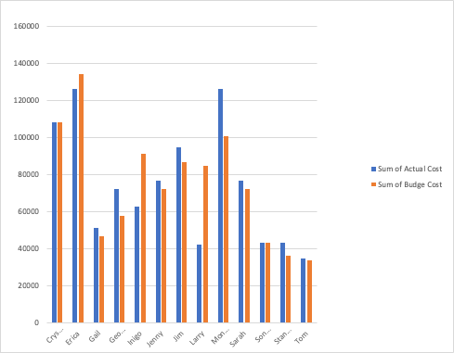
Monique is the most overbudget on cost. Larry is the most underbudget. Tom has the least in both actual cost and budget cost

Slide 6
Observations and Key Insights
Project C is the most overbudget on hours, and Project E is the most underbudget. Project D has the most both budge and actual hours.
Project C is the most overbudget on cost, and Project E is the most underbudget. Project D has the most both budge and actual cost. Project B has the least both budge and actual hours.
Both George and Monique are over budge on the most hours. Larry is the most inder budget .
Monique is the most overbudget on cost. Larry is the most underbudget. Tom has the least in both actual cost and budget cost.
Pesonnel are under budged hours: Erica, Inigo and Larry.
Erica and Monique cost most ($126000), Tom cost least ($34650)
Stanley charges the most projects (12).
Crestal and sondra are good at estimating the hours.
Larry may charge an unrealstic number of hours an the acutaly hours is only half of the budget one.

